Slide 1

Mindful Mornings the RAP Difference!

Slide 2

RAISING ARIZONA PRESCHOOL MINDFULNESS TRAINING 4 Clock hours
10:00 Welcome & Housekeeping
10:10 RAP Commercial Video
10:20 Jared Speaks on Mindfulness
11:20 Stretch and Break
11:30 Mindfulness in the classroom
12:30 Zen Zoo, Props, and Raffle
1:00 Goodbye.

Slide 3


Slide 4
Mindful Mornings the RAP Difference! Understanding the Why with Jared.

Slide 5
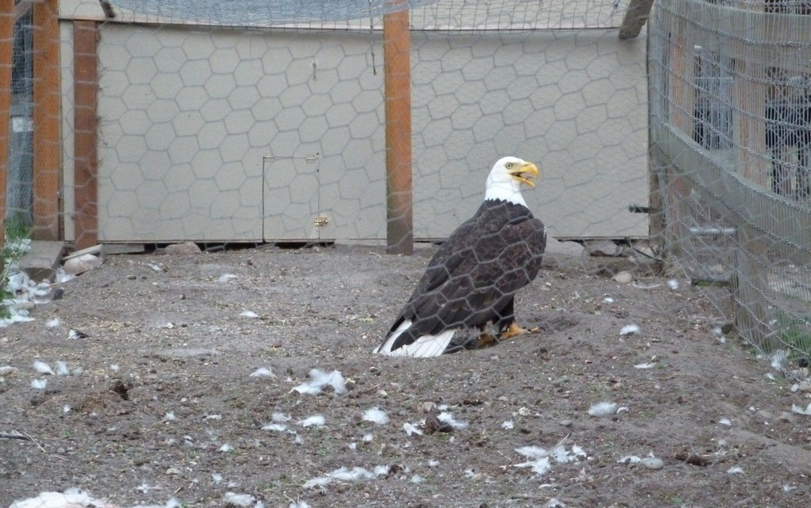
Eagle in Chickens Coup

Slide 6
Narrative = Your story
What is your story?
Where did your story come from?
What parts are good?
What parts are not helpful?

Slide 7
“How can I change my story?”
You are the sum of your thoughts.
95% of the thoughts you have today are the Exact same as yesterday.

Slide 8
Change your Thoughts
CHANGE YOUR FEELINGS
CHANGE YOUR DESTINY

Slide 9

Mindful Mornings
7 Day Challenge.
Do a Mindful Morning breathing exercise
Find Gratitude sometime in the day.
Pay attention to the thoughts that are hurting you and rewrite them.
I AM…

Slide 10
Breathing
You can change your emotional state through breathing, HACK your body
Slow in fast out – Increase adrenaline
Fast in Slow out – tells your brain everything is ok

Slide 11
Gratitude
Why Be grateful?
How to be really, grateful when you don’t feel like it?

Slide 12

Self Affirmations
I am ….
Thoughts that Fire together, Wire together.
Fake it till you make it? Sorta….

Slide 13
So, why Mindful Mornings?
Breath to interrupt your emotional state
Gratitude to change your emotional state
Affirmations to change your story

Slide 14
Mindfulness in the Classroom
Encouraging mindfulness in young children

Slide 15
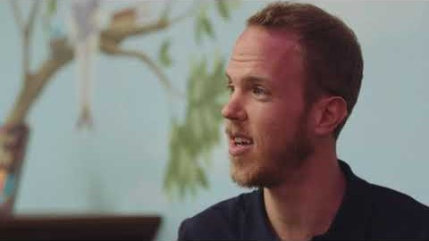

Slide 16
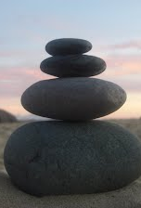
Mindfulness for young children
Create your own practice- You would have trouble teaching how to ride bike if you had never ridden one yourself. Mindfulness is the same, you need to have your own personal practice, so you can model and share with the children in your class.
Keep it Simple- mindfulness activities for children should be simple , easy, and direct.
Check your Expectations- are you expecting mindfulness to stop all classroom behaviors? Maybe you hope it will be a cure all for your life and classroom? While mindfulness is beneficial for stress, focus, and relaxation it is not magical remedy for all your classroom behaviors or personal needs. If you have unreasonable expectation, you will be likely to be disappointed.
Don’t Force it- Please never force it. If the children are not interested at all , and you cannot get them on task, stop, and try again another time. Make the time brief and the activity engaging.
Remember- it takes practice, both personally and for your class. Don’t give up.

Slide 17

What does it look like in the Mindful Morning Circle Time?
Expectations
Ones- 1 Minute
Twos 2- 3 Minutes
Threes 3-5 minutes
Fours 5 – 8 minutes
PreK 5- 10 minutes
How?
Breathing ------Gratitude-------Affirmations
*Affirmations are I am statements I am wanted, I am beautiful, I am kind…

Slide 18
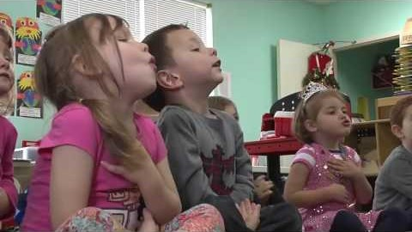
Mindfulness is and IMPORTANT PART OF YOUR DAY!
At RAP we embrace Mindfulness for both children and staff.
Each day you should be practicing age-appropriate mindfulness with your children.
This is not an option but a required part of our curriculum.
If you need help with ideas, please ask.

Slide 19

ZEN ZOO Props/Tools

Slide 20

When you have no tools
Use yourself! Not all activities needs props or tools.

Slide 21
Mindful Morning in action…
JACKIE VIDEO INSERT HERE

Slide 22
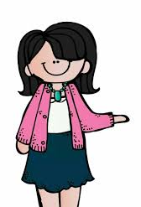
Group Activity
Mindfulness Group Activity
Show and Share (hands on activity using tools)
& Handout (when you don’t have tools?)

Slide 23
Group Activity 20 Mins.
Small Groups (by age of children worked with, group up with someone NOT from your center)
1.Choose and Item from table an create a Mindful Morning using the tool or prop
2. Choose an activity using only your self NO PROP or Tools
Practice the activity and take turns switching roles (teacher/children)

Slide 24

Practice Mindfulness Yourself!

Slide 25


Slide 26
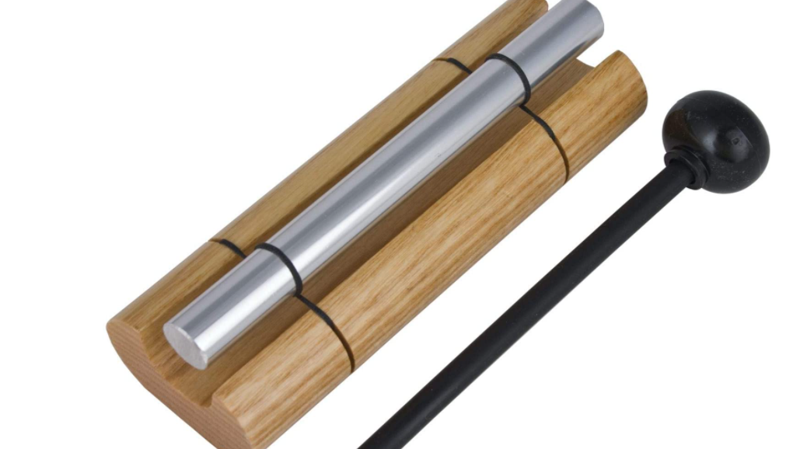
RAFFLE
See if you win a mindfulness tool?

Slide 27
Let’s watch the RAP video again, through the lens of what you have learned today.
Open Discussion
Q & A

